Slide 1
STATEMENTS IN PYTHON

Slide 2
STATEMENTS
Statements are the instructions given to the computer to perform any kind of action.
Statements from the smallest executable unit within a Python program.

Slide 3
TYPES OF STATEMENTS
In a program statements may be executed sequentially, selectively (based on a condition) or iteratively (repetitively).
Sequence
The sequence construct means the statements are being executed sequentially. This represents the default flow of statement. Sequence refers to the normal flow of control in a program.
Selection
The selection construct means the execution of a statement/statements depends upon a test condition.
If the condition evaluates to True, a set of statements is executed. Otherwise, a different set of statements is executed.

Slide 4
TYPES OF STATEMENTS (Contd.)
Iteration (Looping)
Iteration construct means repetition of a set of statements depending upon a test condition.
The set of statements that are repeated again and again is called the body of the loop.
The condition on which the execution or exit of the loop depends is called the exit condition or test condition.

Slide 5
SELECTION STATEMENTS

Slide 6
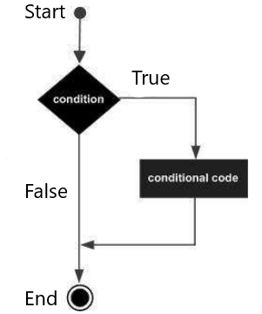
if STATEMENT
The if statement contains a logical expression using which the data is compared and a decision is made based on the result of the comparison.
SYNTAX
if <logical expression>:
#statements

Slide 7
if STATEMENT (Contd.)
Program for Displaying Division by Zero Error
n = int(input(“Enter a number: ”))
d = int(input(“Enter a number: ”))
if d==0:
print(“Division by Zero is not possible!”)
Here, if the denominator is not equal to zero (the if condition is False), nothing happens and the program ends.

Slide 8
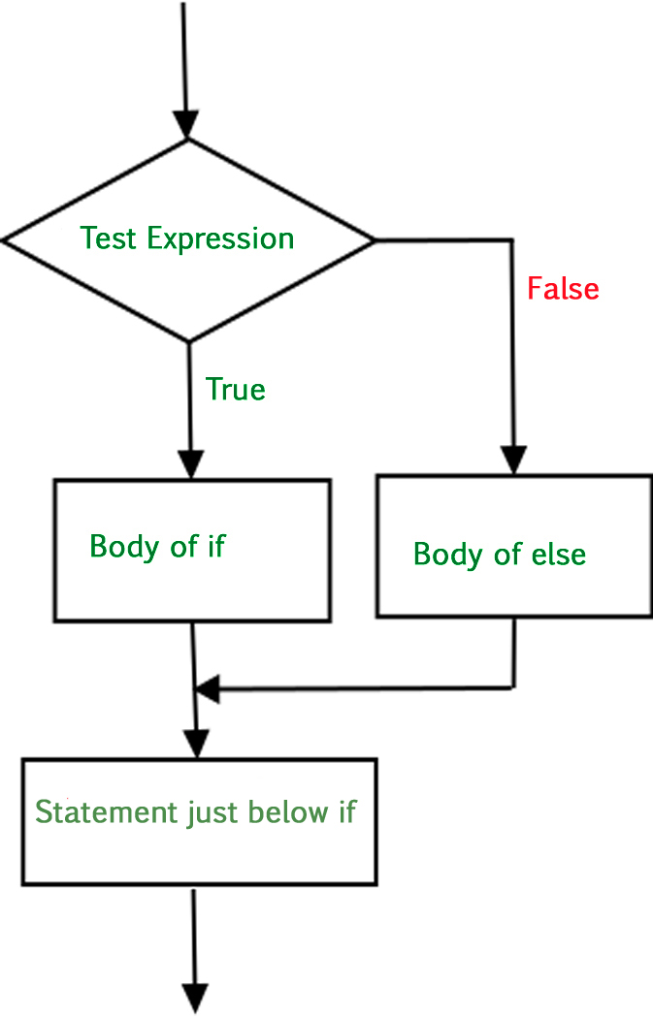
if-else STATEMENT
An else statement can be combined with an if statement. An else statement contains a block of code that executes if the conditional expression in the if statement resolves to 0 or a False.
The else statement is optional and only one else statement must follow the if statement.
SYNTAX
if <logical expression>:
#statements
else:
#statements

Slide 9
if-else STATEMENT (Contd.)
Program for Displaying Division by Zero Error
n = int(input(“Enter a number: ”))
d = int(input(“Enter a number: ”))
if d==0:
print(“Division by Zero is not possible!”)
else:
print(“The quotient is”, n/d)
Here, if the denominator is not equal to zero (the if condition is True), the error message is printed. But if

Slide 10
INDENTATION
Blocks of code are denoted by line indentation.
Indentation is a method of grouping statements.
All statements within the block must be indented the same amount.
You will get an error if indentation is not specified properly.
To end a block, write the next statement with the same indentation before the block started.

Slide 11
INDENTATION (Contd.)
EXAMPLE CODE
if d==0:
print ("Answer")
print ("True")
else:
print "(Answer")
print ("False")
print(“End of Block”)
Here, the condition in Purple (following if) is a logical condition which can have only two values – True or False.
The statements in Green (under if) denotes the if block and will be executed if the if condition is True. The statements in Grey (under else) denotes the else block and will be executed if the if condition is False.
The statements in Yellow is not part of any block and executes after one of the block (either if or else) gets executed.

Slide 12
if-elif-else STATEMENT
The elif statement allows you to check multiple expressions for TRUE and execute a block of code as soon as one of the conditions evaluates to TRUE.
The elif statement is optional.
There can be any number of elif statements following an if.
SYNTAX
if <logical expression1>:
#statements
elif <logical expression2>:
#statements
elif <logical expression3>:
#statements
else:
#statements

Slide 13
if-elif-else STATEMENT (Contd.)
Program for Displaying Division by Zero Error
num = int(input(“Enter a number: ”))
if num<0:
print(num, “is negative.”)
elif num==0:
print(num, “is equal to 0.”)
else:
print(num, “is positive.”)

Slide 14
if-elif-else STATEMENT (Contd.)
Here, if the number is less than zero (the if condition is True), the message in the indented block under if is printed.
If the if condition is False, then the elif condition is checked (the number is equal to zero). If this condition is True, the message in the indented block under elif is printed.
Otherwise, that is, if both if and elif conditions are False, then the message in the indented block under else is printed.

Slide 15
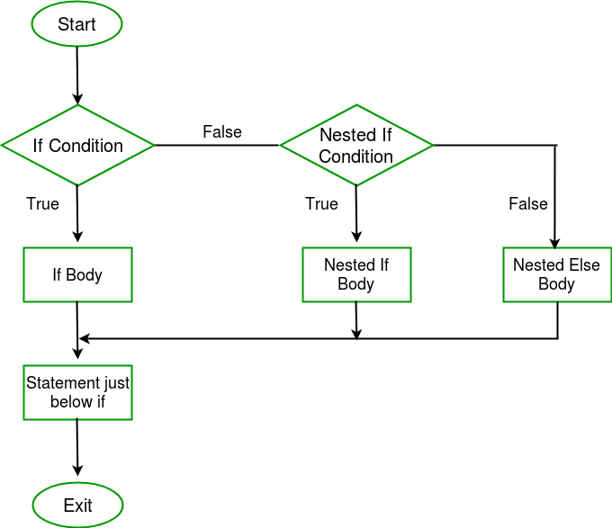
NESTED if STATEMENT
There may be a situation when you want to check for another condition after a condition resolves to True.
In such a situation, you can use the nested if statements.
SYNTAX
if <logical expression>:
#statements
if <logical expression>:
#statements
else:
#statements
else:
#statements

Slide 16
NESTED if STATEMENT (Contd.)
Program for Displaying Division by Zero Error
num = int(input(“Enter number:"))
if num%2==0:
if num%3==0:
print("Divisible by 3 and 2")
else:
print("Divisible by 2, not divisible by 3")
else:
if num%3==0:
print("Divisible by 3, not divisible by 2")
else:
print(“Not divisible by 2, not divisible by 3")

Slide 17
NESTED if STATEMENT (Contd.)
Here, divisibility by 3 (nested if condition) is checked after checking for the divisibility by 2 (only if the main if condition evaluates to True). If the nested if condition (inside if) is False, then the else under the nested if (inside if) gets executed.
If the main if condition is False, then the if block will not be executed. Then, we will go into the main else block and the nested if inside the main else is checked (divisibility by 3). If the nested if condition (inside else) is False, then the else (inside else) under the nested if gets executed.

Slide 18
POINTS TO REMEMBER
Only one of the if-elif-else blocks will be executed.
If none of the conditions in if and elif evaluates to True, then the else block will be executed.
In an if-elif-else block, the first condition that evaluates to True will be executed.
As soon as one of the condition becomes True, the block will be executed and the rest of the blocks are neglected/ignored, that is, they will not be executed.

Slide 19
Happy Learning!

